Slide 1
Employee Data Analysis using Excel
STUDENT NAME: Aadhithyavarman KNA
REGISTER NO: 312201549
DEPARTMENT: commerce
COLLEGE. Prof. Dhanapalan college of science and management

Slide 2
PROJECT TITLE
Employee Performance Analysis using Excel

Slide 3


AGENDA
Problem Statement
Project Overview
End Users
Our Solution and Proposition
Dataset Description
Modelling Approach
Results and Discussion
Conclusion
3/21/2024 Annual Review

Slide 4
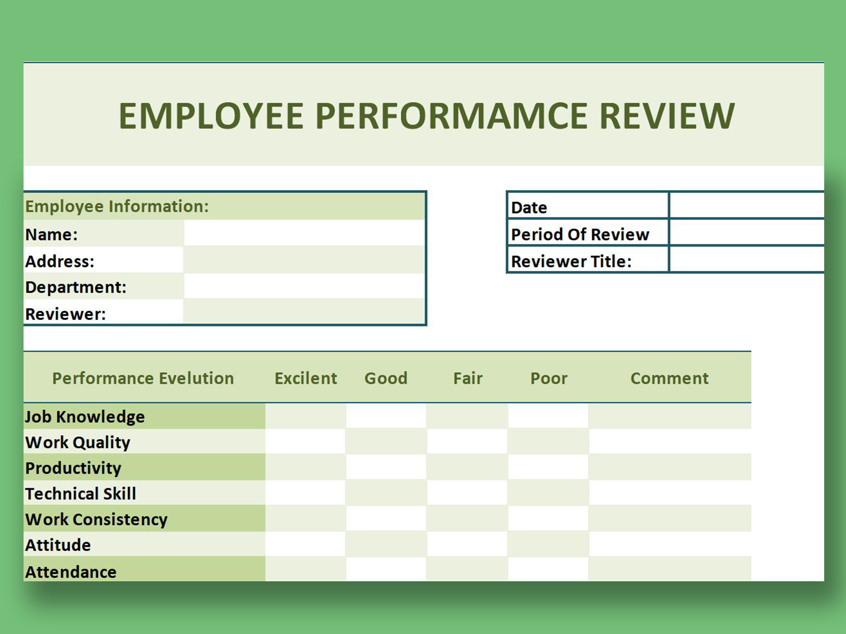

PROBLEM STATEMENT

Slide 5
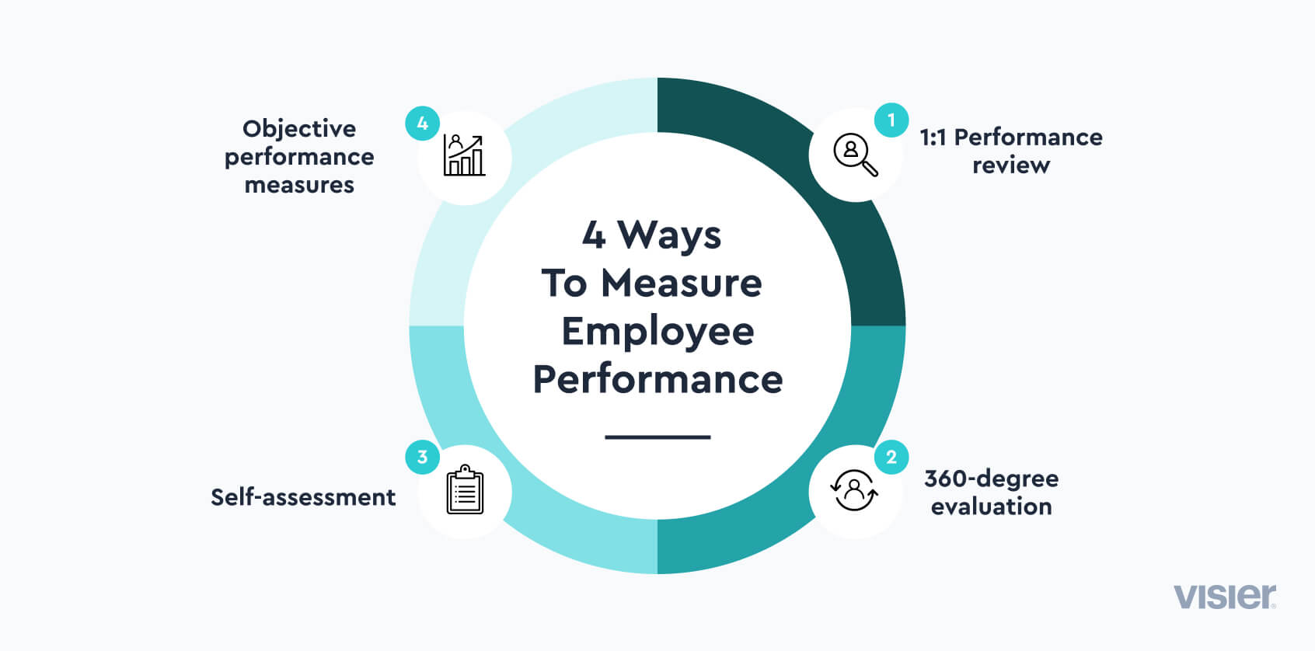

PROJECT OVERVIEW
.

Slide 6

WHO ARE THE END USERS?
The term end user typically is the people your products or services are designed for. They are often your customers, defined as people who purchase products from you.

Slide 7


OUR SOLUTION AND ITS VALUE PROPOSITION

Slide 8
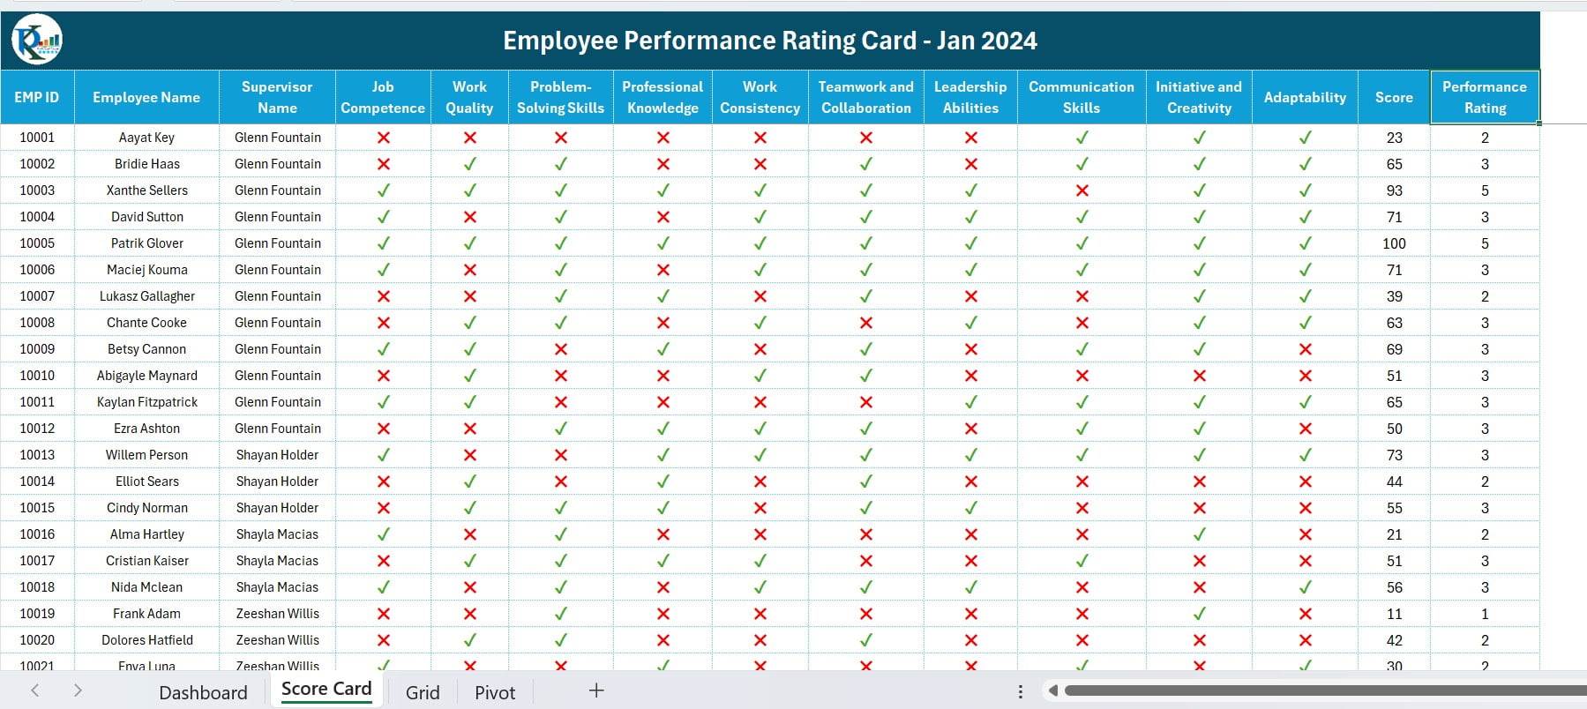
Dataset Description

Slide 9


THE "WOW" IN OUR SOLUTION
Personalization.
Offer Seamless Experiences.
All hands on deck - Provide Great Customer Support.
Use Augmented Reality.
Use Gamification.
Use Social Media.
Support Sustainability.
Human Connection.
3/21/2024 Annual Review
9

Slide 10
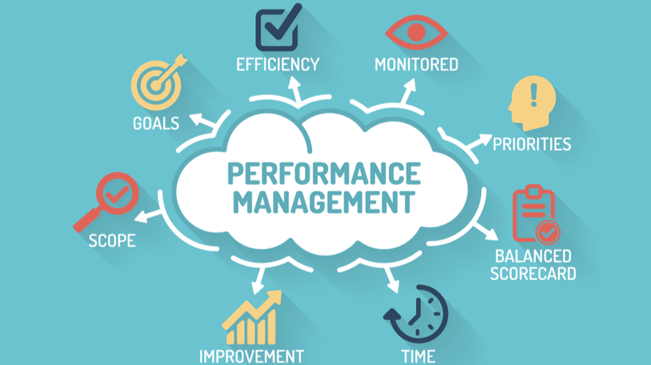
MODELLING
10

Slide 11
RESULTS
A performance discussion is an integral part of an organization. It helps in finding potential employees and providing them with the right opportunities and skills to excel in their careers.
11

Slide 12
conclusion
An Excel-based Employee Performance Rating Card and Dashboard is very useful and adaptable tool. It can significantly enhance your performance management process.

